Slide 1
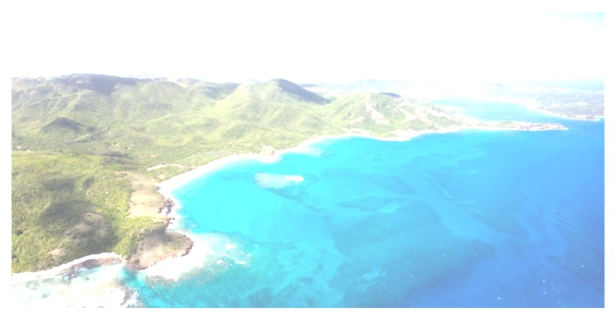
Clean Energy for ALL
The importance of new emerging power generating technologies can't be over-stated. For the past 120 years, the world has been powered by fossil fuel and the terrible scars it has left behind are undeniable. From air, ground and water pollution to the degeneration of our communities to the ultimate, very complicated but very real polar melt down due to global warming. There is no doubt, climate change is here and it's due to our own need for power. The industrial revolution turned the lights on and we can't seem to be able to turn them off. And automobiles are permanently here to stay in one form or another.
With the right technology, humans on earth today can live better and smarter and yet be in harmony with our environment. Clean, inexpensive power is the beginning. Abundant power, water, clean safe living environments are now available. CLEAN ENERGY is an inalienable rights that all posses. WE can make it happen.

Slide 2
Sustainable Solutions Consulting, LLC
SSC is founded on the principals of sustainable design and construction. And so to that end, we have made it our mission to re-analyze design and construction practices and how in turn, we can break the paradigm shift and make our structures/projects more efficient and cost effective to build and operate.
Nature has given us the RIGHT answers and it not fossil fuel.
Global carbon emissions from fossil fuel use were approximately 9.795 gigatonnes (Gt) in 2014 (or 35.9 GtCO2 of carbon dioxide). Fossil fuel emissions were 0.6% above emissions from 2013 and 60% above emissions from 1990. This represents well over 100 times more CO2 then all of the volcanoes on Earth do.
According to the United States Environmental Protection Agency, in the United States the combustion of fossil fuels to generate electricity accounts for 37% of total CO2 emissions and 30% of total green house gas emissions. And with more developing countries requiring more electricity, the release of CO2 and other harmful chemicals and gases are growing exponentially. C02 could have disastrous consequences on; sea levels, agriculture, ozone layer, extreme weather, spread of disease and eco-system changes.
Notes:
Sustainable Concepts Development, Corp. is founded on the principals of sustainable design and construction. And so to that end, we have made it our mission to re-analyze design and construction practices and how in turn, we can break the paradigm shift and make our structures/projects more efficient and cost effective to build and operate.

Slide 3
8 Elements for Sustainability
Our efforts have made us look at every aspect of a building and site. We no longer adhere to inefficient and costly systems or materials. Let us introduce the 8 elements of sustainability.
Power generation
Desalination / Atmospheric Water Generator
Grey-water recycling
Black-water recycling
Self Contained Sustainable Community
Sips building panels
In situ Road/Street Construction without concrete or asphalt
Environmentally controlled farming

Slide 4
1. Power Generation
The PAAR Energy Systems redefines electrical energy generation. It provides access to an inexpensive, continuously available, and non-polluting method for generating electrical energy in a format specifically designed for residential use or portable/temprary applications. The PES is currently available in 15KW, 50KW, 80W and 300KW, with other sizes currently in design. It is easily customizable to many applications.
Flexibility and functionality are key elements of the PES. The PES can be affixed to existing individual residential structures as the only means of power generation in rural, urban or heavily developed areas. The PES can also function as a stand alone energy source for temprary housing, field medical facilities, emergency power, agricultural centers, camp sites
It is a disruptive technology.

Slide 5
Levelized Cost of Energy
The PAAR Energy Systems
Levelized Cost of Energy =
$0.04 per KWH
Imagine; Clean, no heat, little noise, no vibrations, no harmful odors or radiation and best of all – NO FUEL.

Slide 6
2. Desalination/Atmospheric Water Generator
Desalination is the process by which salt and other minerals are removed, in particular, from sea water and made usable by humans. This technology has become common place in the 21st century. But the brine left behind and introduced back into the oceans has become a major factor in the polluting of our oceans. But by using our patented brine recycling system, potable water is possible without harming the environment and inexpensive.
By using the patent pending “From Air to Water Generator” by GR8 Water, you can be confident that your private water supply will not only be delicious and affordable, but also secure, pure and plentiful into the future. With millions of people suffering and dying from water born diseases worldwide, GR8 Water intends to replace their hazardous and contaminated ground sources water with the finest drinking water possible. It can be yours too. Can produce upwards of 1,200 gallons per day.

Slide 7
3. Grey-water Recycling
Grey-water is gently used water from your bathroom sinks, showers, tubs, and washing machines. It is not water that has come into contact with feces, either from the toilet or from washing diapers. Grey-water may contain traces of dirt, food, grease, hair, and certain household cleaning products, that can be managed during the recycling process. Typically 50% to 80% of a households water discharge is Grey-water and with the right recycling process can be used again and again.
GR8 Water Filtration System :
GR8 Water Inc. has taken the solution of water/wastewater treatment to a new level of simplicity, cost effectiveness and performance. Each filtration system uses only physical chemical processes to remove and separate organic solids. Through this process, a high quality, reusable water is produced, to specifications set by each customer. The pre-engineered system is designed into a contained package that is delivered, worldwide, for quick and easy ‘plug and play’ installation.

Slide 8
4. Black-water Recycling
Black-water is any wastewater that originates in toilets or urinals from either residential homes or commercial/industrial buildings. The treatment of black-water requires much more energy and time. And so, engineers today are making great strides in developing technology that will allow us to be safe and employ environmentally sound practices for treating/recycling black-water.
GR8 Water Inc. Pre-engineered Package Treatment Plants is a new and unique solution to an age old problem. The system treats wastewater produced by sewage works or industrial manufacturing processes. However, in contrast to grey-water processing, black-water is treated to the point of it becoming grey-water and used for non-potable uses, such as; water used to flush toilets or irrigation.
Each project has varying circumstances and requirements, that's why GR8 Water Inc. along with other experts can come up with a solution uniquely suited to your project.

Slide 9

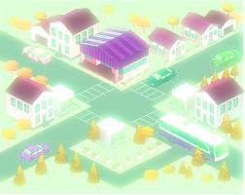
Self Contained Sustainable Community
5. Self Contained Sustainable Community
As a self contained sustainable community, able to sustain approximately 600 homes, flourishing without having to exploit the Earth's resources and without the need of continuous contamination of our precious environment.
In a self contained sustainable community, you live in harmony with your neighbors and your surroundings. NO need of source water or existing infra-structure.
All SCSC will have;
Potable water – meets the Canadian Potable Water Standards
Greywater recirculation - filtration, and sterilization
Power Generation – up to 600 homes and all community amenities
Sustainable Homes – home construction able to meet any size and finish requirement
Streets and Roads – without the need of asphalt or concrete
Black Water – is eliminated cleanly and without environmental contamination

Slide 10
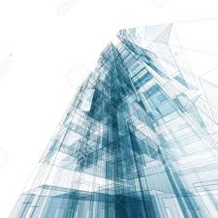
6. SIP's Building Panels
Steel Insulated Panels are prefabricated building panels made in a factory. The panels are generally 4' wide and could be made in lengths appropriate to the project and restricted only be logistics.
The steel skins on both sides (22 ga.) can have any number of finishes and colors and the roof panels can have the architectural seams built right to the panel.
The high density foam prevents water intrusion to .0001%, no flame spread, no noise transmission and its recyclable.
As a composite panel it is; earthquake resistant, hurricane resistant and approved by Dade County Product Approval, R value approximately 50, A/C load reduction by 50% and energy load reduction and construction schedule friendly.
The panels are also structurally self-supporting up to 30' high. Can be used as exterior wall panels and floor panels. For concentrated loads easy adjustment to the floor joists is all that would be required.

Slide 11
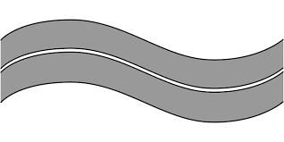
7. In Situ Road/Street Construction
Natural Paving Solutions road paving and soil stabilizing products are used either as a Topical or Admix method to form a technologically advanced paving system method of use.
All products are non-toxic, eco-friendly, water based solutions that are delivered as a concentrate. The contractor would mix the required product specially formulated products with water and apply to the soil or aggregate.
Utilizing various mixing ratios, soil depth and compacting methods, the contractor is able to achieve higher CBR strengths, producing a stronger roadway.
The system uses the ‘Admix’ or ‘Topical’ methods to pave and or soil stabilize giving you a superior soil stabilized sub-surface and an advanced chip seal surface. A faster finished project with greater strengths.
The method and system of road paving can save you as much as 60% when compared to traditional roadway designs.

Slide 12

8. Environmentally Controlled Farming
Aquaponics is the combination of recirculation aquaculture and hydroponics. In aquaponics, you grow plants and fish together in one integrated system. The fish waste provides a food source for the growing plants and the plants provide a natural filter for the water the fish live in. This creates a sustainable ecosystem where both plants and fish can thrive. Aquaponics is the ideal answer to a fish farmers problem of disposing of nutrient rich water and a hydroponic growers need for nutrient rich water.
Given the nature of recirculating aquaculture and hydroponics, the two technologies combined in aquaponics, there are 2 consistent factors in all aquaponic systems. 1. Fish are raised in tanks. 2. It is a soil-free growing system.
Aquaponics is a completely natural process which mimics all lakes, ponds, rivers and waterways on earth. The only input to an aquaponic system is fish food. The fish eat the food and excrete waste, which is converted (by beneficial bacteria) to a form that that plants can use. In consuming these nutrients, the plants help to purify the water. You can not use herbicides, pesticides or other harsh chemicals in an aquaponic system, making the fish and plants healthful and safe to eat.

Slide 13

Contact Us
Energy, Water, Efficient Construction and Roadwork and Farming is the solution:
Sustainable Solutions Consulting, LLC
Aldo Paredes
561-436-9773
aldo@sustainableconceptsdevelopment.com
www.sustainableconceptsdevelopment.com

